Slide 1


Slide 2
Site setup questions
What is the expected distance from the number plate to the camera?
What would the average speed be of the vehicle when recognition occurs?
Will the vehicles be traveling toward or away from the camera?
Is the camera mounted directly in front of – or to the side of the license plate?
If to the side, how far to the side?
Do the license plate colours need to be detected?
What lighting conditions are there?
Will IR lighting be used?
These questions help to determine the correct camera specification required to successfully and accurately detect the license plates
Camera setup questions
What is the model number of the camera?
What is the maximum resolution of the camera?
What size image sensor does it have?
What is the min and max focal length of the lens?
These questions help to determine if an existing camera is capable of successfully and accurately detect the license plates on the site

Slide 3
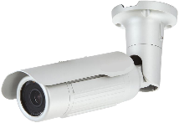
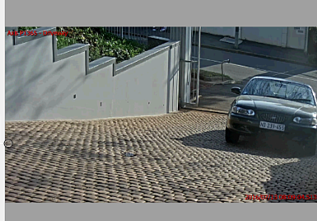
Setting up the ANPR
Advances in chip design, and production techniques are bringing License Plate Recognition capabilities into lower priced cameras very rapidly.
With these lower price level, and lower spec cameras a person should keep their expectations modest.
Distance, lighting, speed of vehicle and camera specs like image sensor size, focal length, and megapixels are all factors that will impact your degree of success.
Ultimately, it will come down to lighting and how many pixels you have to work with. Generally if the height of the license plate font occupies 20 vertical pixels in the captured image, then letter and number definition and hence recognition can occur
As an example, at 10 Meters, using a 2Mega pixel camera with a 1/3” sensor and a 8mm lens , viewing a standard 520mm X 113mm license plate, with 8 letters and numbers on it and who’s font height is 75mm, will most likely achieve about an 18 pixel font height. ( this should usually result in successful recognition)
20 pixels

Slide 4
To increase the distance that a camera would be able to successfully read the license plate would require
changing the lens for one with a longer focal length
Keeping with the same camera in the previous example, to be able to successfully read the license plate at a distance of 20Meters, would require a lens with a focal length of about 40mm .
So a varifocal lens say 20-50mm would be sufficient to fit to the camera
When choosing a replacement lens, care must be taken to choose a lens that is designed for the camera sensor size as well as the type of mount either a type CS or C
Common IP CCTV cameras use a CS mounted lens and have a sensor size of either 1/2.8” 1/3” and 1/4” but this must be verified for your camera
If a varifocal lens is fitted, choose the longest focal length setting so that the field of view is as narrow as possible
NOTE:
The smaller the sensor size, the more light you need
The larger the sensor size, the shorter the distance you can effectively use
The shorter the camera focal length, the shorter the distance
The longer the focal length, the more light you need
The faster the shutter speed the more light you need
The slower the shutter speed, the higher the susceptibility to blur

Slide 5
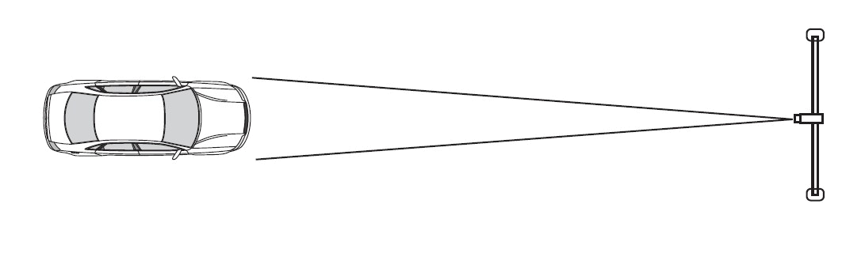
Camera Mounting
Installing the camera in the front (Recommended):
Install the camera in the upper front of the vehicle as shown below, but not too low, to avoid direct headlights ‘blinding’ the camera
Be sure to install the camera so that the height of the captured plate characters would approximately fall between 19 and 25 pixels, at the furthest point of capture.
Make the field of view at the capture point as narrow as possible

Slide 6
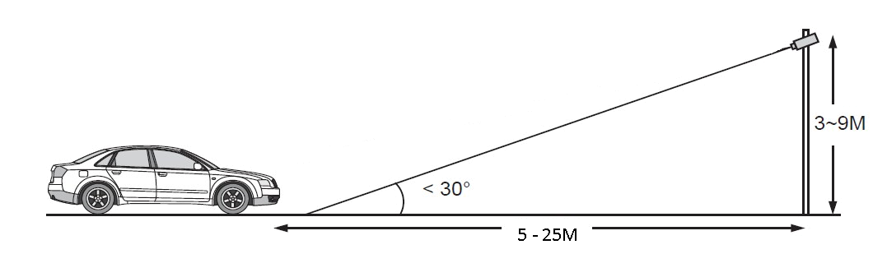
The distance between the vehicle and the camera should be within 5 to 25 meters ; the camera height should be within 2 to 9 meters ;
The camera setup angle should NOT exceed 30 degrees.

Slide 7
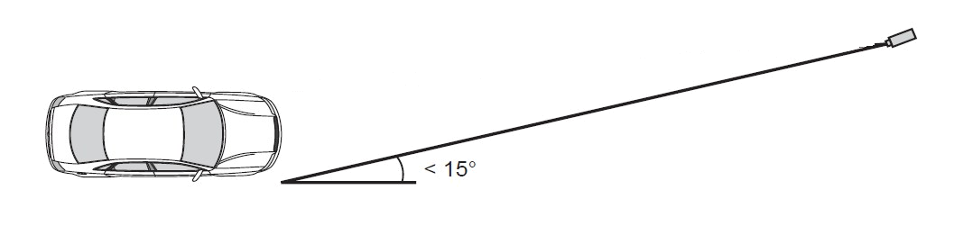
Installing the camera on the side:
Install the camera to the side front of the vehicle as shown below. To avoid capturing unnecessary contents in the image, the camera should be installed in a higher position to capture the front part of the vehicle only.
The camera setup angle should not exceed 15 degrees.

Slide 8
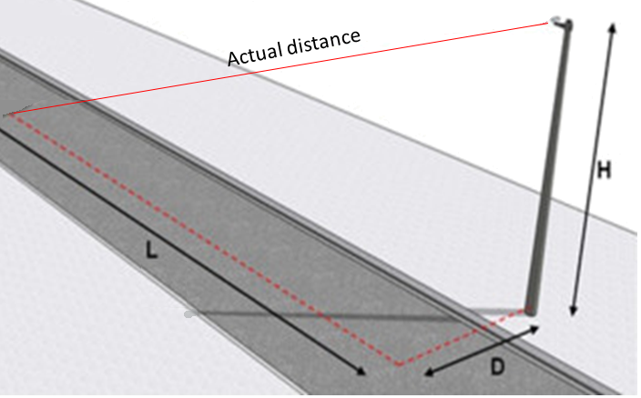

Slide 9
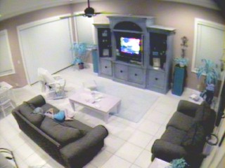
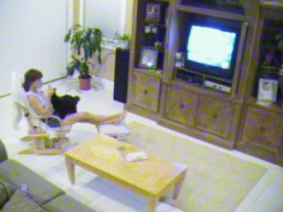
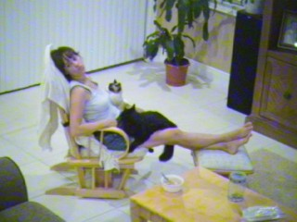
Understanding Focal Length – Angle of View – Field of View
3.6mm Fixed Lens - 72° View 6mm Fixed Lens - 43° View 12mm Fixed Lens - 22° View
Comparing the focal length settings we can see the shorter the focal length, the wider the angle of view,
and hence the larger the field of view and less detail
The longer the focal length, the smaller the angle of view and hence the smaller the area that is covered,
resulting in more detail
So if your camera has a varifocal lens, and you want to capture license plates, then if the lens is a 3.6 to 12mm varifocal,
Set the lens to 12mm or far
Remember, the longer the focal length, the more light is needed

Slide 10
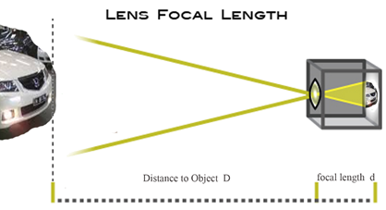
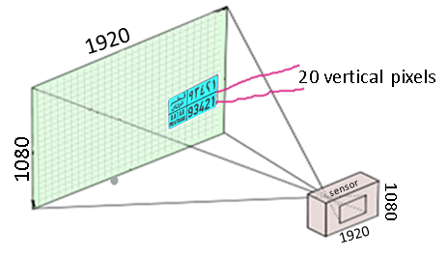
Why do we need to know the camera sensor size and focal length?
2Megapixel camera 1920 x 1080
Sensor size 1/3 “ ( see last slide for table with dimensions)
Focal length 3-8mm
The ratio of focal length to distance to object is the same as the ratio of sensor size to field of view,

Slide 11

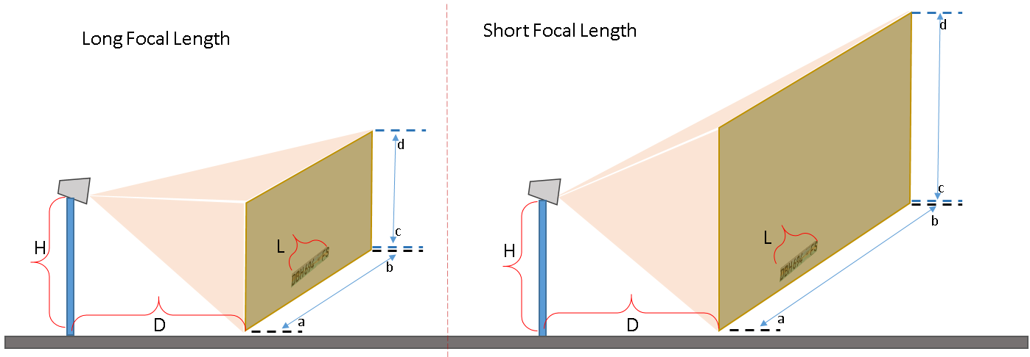

x
x
y
y
Distance D is the same in both cases = D Plate width L is the same in both cases = L Camera height H is the same in both cases
Distance a-b is shorter for a longer focal length Distance a-b is longer for a shorter focal length
Image height c-d is shorter for a longer focal length Image height c-d is longer for a shorter focal length
Actual distance to plate x-y is same in both cases
Example:
a 2Meg Pixel camera with a ‘1/3 sensor mounted 10 meters away from the license plate
with a 3mm focal length will have width a-b = 16Meters
height c-d = 12Meters
therefore 1080 pixels across the height of 12 meters ( 12000mm)
so this means 1mm = 0.1 pixel (1080/12000=0.09)
so license plate font is 75mm 7.5 pixels = too small for recognition
with a 8mm focal length will have width a-b = 6Meters
height c-d = 4.5Meters
therefore 1080 pixels across the height of 4.5 meters ( 4500mm)
so this means 1mm = 0.25 pixel (1080/1200=0.24)
so license plate font is 75mm 18 pixels = usually recognitions occurs
A 2Meg camera has a resolution of
1920 x 1080 pixels
Standard license plate dimensions are
520mm x 111mm
Standard license plate font height
75mm
Ratio:
Sensor width Field of View a-b Distance to Plate x-y
Sensor height Field of View c-d Camera focal length
=
=

Slide 12
License Plate Font Heights and Widths
There are only three legal size number plates in South Africa, namely
    520 mm x 113 mm - Only 75 mm letter type allowed
    250 mm x 205 mm - Only 75mm letter type allowed
    250 mm x 165 mm – Only 60mm letter type allowed
The 440 x 120 mm size number plate may not be used on vehicles that were registered for the first time on or after 1 Jan 2010.
(National Road Traffic Act of 1996, Regulation 35. Display of Licence Number, Sub-regulation 10 & Government Gazette No: 29865 of 4 May 2007, Clause 9(f)).

Slide 13
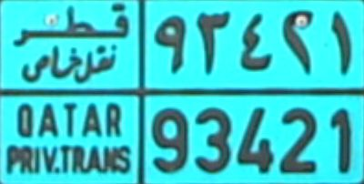

Setting the capture area
Image Dimensions
1. Latin characters require the characters on the license plate to be at least 16 pixels high at the point of capture.
2. Special characters (Arabic, Chinese etc.) will require a character height of at least 20 pixels at the
point of capture. (The language engines are region specific. Make sure you have downloaded the
correct engine for your region.)
3. The whole license plate needs to be visible in the image.
4. Set the camera field of view as narrow as possible
This is the font height and should be 20 pixels or more high in the image
20 pixels high at the furthest capture point

Slide 14
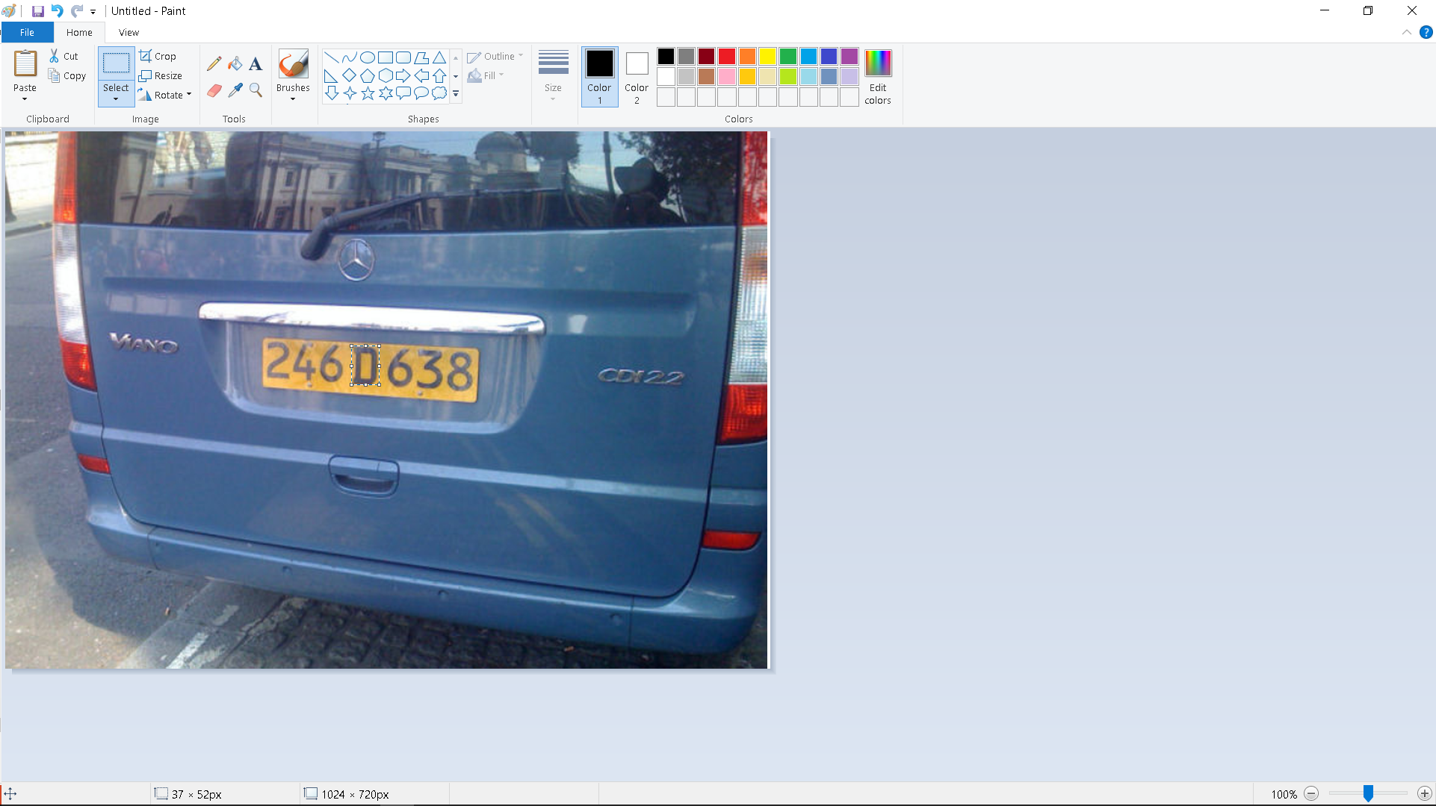

Crude but effective method of checking the font height
From CathexisVision, export a snapshot ( right click – EXPORT SNAPSHOT) of the scene with a license plate in it.
Without cropping the image import it into a simple graphics program, like MS Paint
Highlight a letter or number in the plate and check if it is at least 20pixels high
It MUST be an uncropped snapshot
of the scene
52 pixels high --

Slide 15


Setup a narrow as possible field of view or capture zone
Set-up the field of view or capture area in such a way as to reduce the possibility of having two number plates in
the capture area at the same time. In the scene above imagine that the ANPR capture takes place with motion,
vehicle BB01BB is parked and the vehicle with ABC 1234 plate arrives at the capture zone, -- in the graphic on the right,
the parked vehicle is ignored, while on the left it is the easier plate BB01BB ( more pixels) and will be used,
while ABC 1234 will be ignored

Slide 16
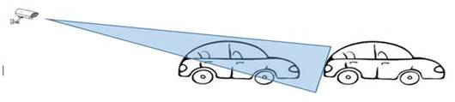
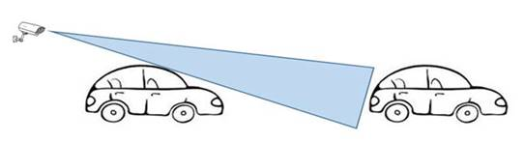
Placing camera to take rear number plates
There is no reason why the cars cannot be read from the back, however
a gap needs to be created between the cars, so that the individual license plates are visible
This is often done using a strategically placed speed bump/s or rumble strips

Slide 17
Setting up the camera
Frame Rate set the frame rate to between 20 and 30 Frame per second
CBR / VBR With VBR, the compression level is fixed, and bandwidth varies to ensure each scene is compressed
at that level. Keeping image quality fairly constant
With CBR, the bandwidth is fixed, so the compression level has to adjust when the scene changes.
This gives an image of varying quality
So make the camera setting VBR
Compression Higher image compression leads to less clear images, or stated another way, a higher quality image
needs lower image compression
Set the camera stream to ‘Low Compression’ or ‘ High Quality’
Bitrate Set the bitrate higher to ensure a higher quality picture
This leads to clearer images, and consequently more accurate and quicker captures
Camera Specific
Shutter Speed to reduce blurred images that result from vibrations as well as motion, set the shutter speed to
between 1/120 and 1/1000 – as the motion increases, increase the shutter speed to give the
clearest image
Speed < 30 Km/Hr 1/120 – 1/200
30 – 60 Km/Hr 1/225 – 1/500
> 60 Km/Hr 1/500 – 1/1000
NOTE – the higher the shutter speed, the more light that will be required
Gain The most popular gain dB setting of 9dB is generally sufficient, higher gain settings are acceptable,
but remember, the higher the gain, the more noise that gets introduced into the image, and this
reduces the recognition capabilities Less gain is needed if WDR is on
WDR WDR ‘lights’ up the scene, but at higher speeds it is better if WDR is disabled as it can affect the
camera’s ability to recognise number plates
The brightness, sharpness and contrast setting is usually where the “tweaking” comes in and that needs to be site specific.
A very defined black and white image seems to do the trick.

Slide 18
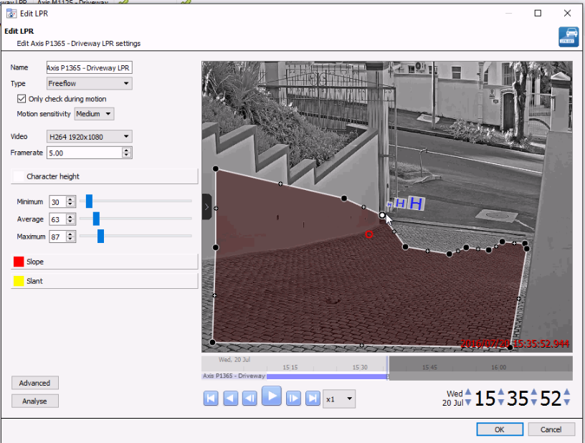
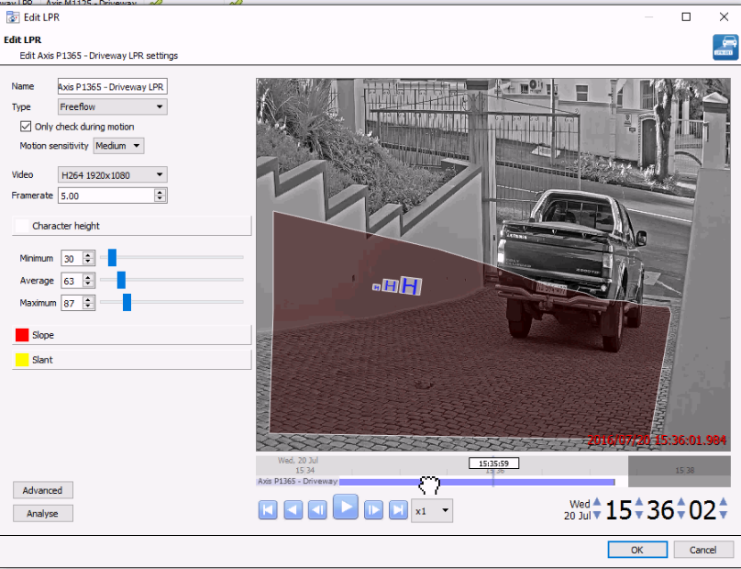
Select the correct camera
Select the correct video stream
Choose the frame rate
a frame rate of 5 means that – the software will the
read the frames such that it uses 5 frames in a second
ie if camera is set at 20fps – the ANPR uses every 4th frame
if the camera is set at 30fps – the ANPR uses every 6th frame
if the camera frame rate is 60 fps – the ANPR uses every 12th frame
Select an appropriate capture area
Adjust the character size – pay attention to the
minimum and average and maximum

Slide 19
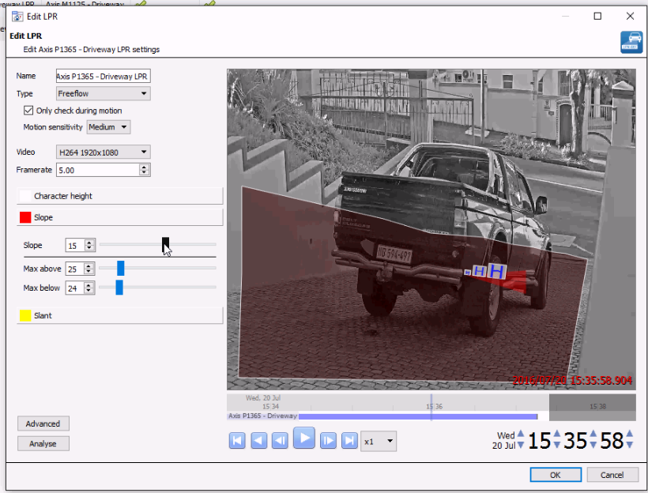
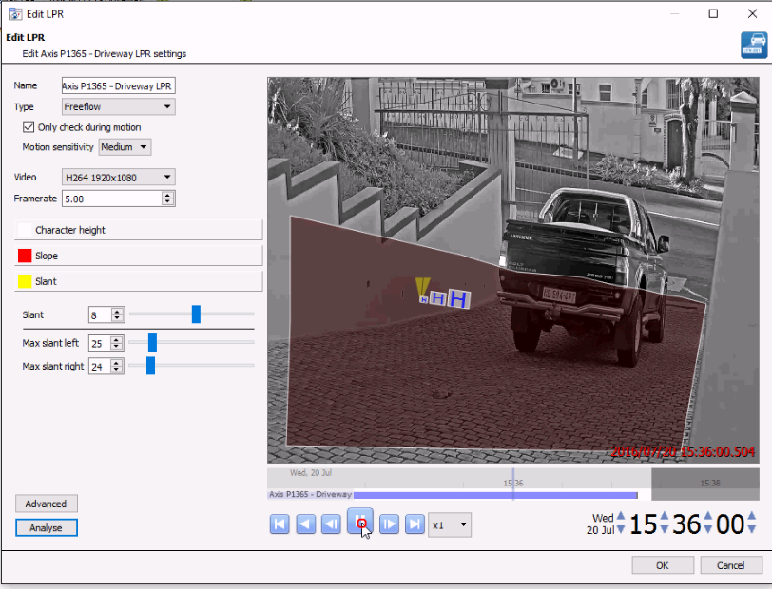
Edit LPR Settings
Adjust the font slope and slant
make sure to include the appropriate variation levels

Slide 20
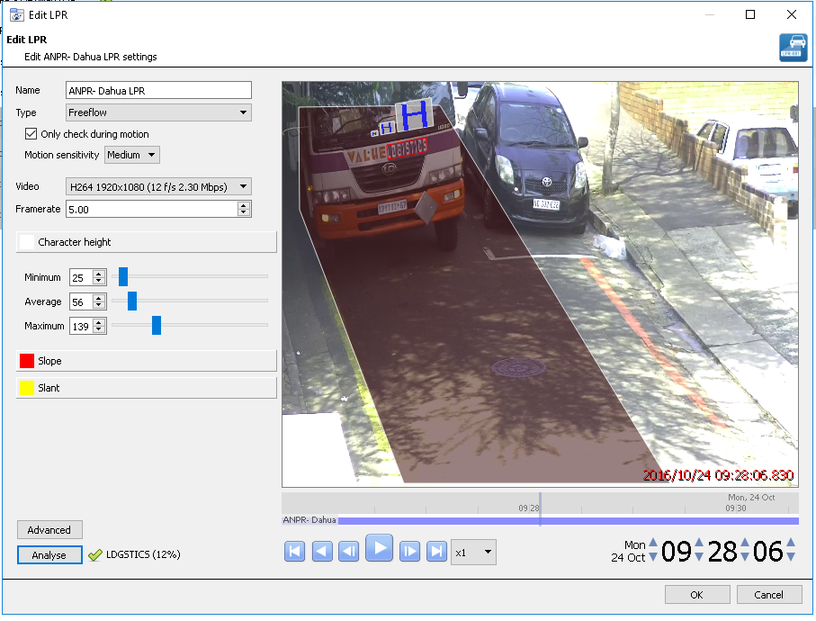
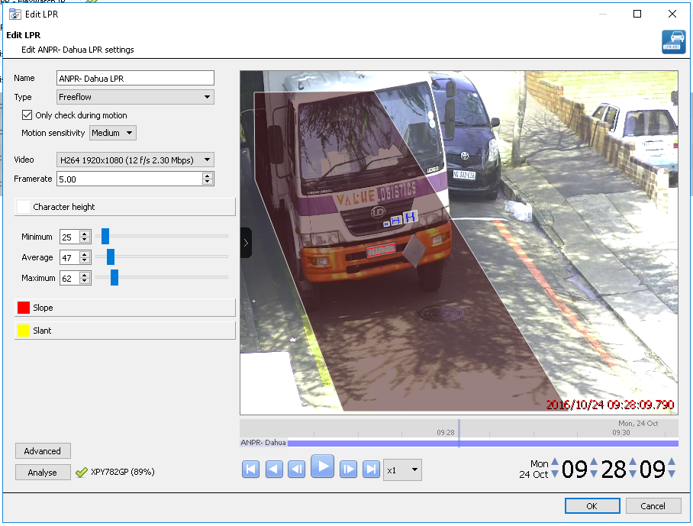
Setting the Character Height
Even though the software is detecting license plates, and a license
plate is in the capture area, incorrect or false positives can cause a
headache
This problem can be reduced by correctly adjusting the
Character Height setting
Notice in the image that the maximum size character height is
very large. Many times, what this does is allow any surrounding
writing to be recognised as a clearly visible license plate
What should be detected is the license plate and preferably not
the surrounding writing

Slide 21
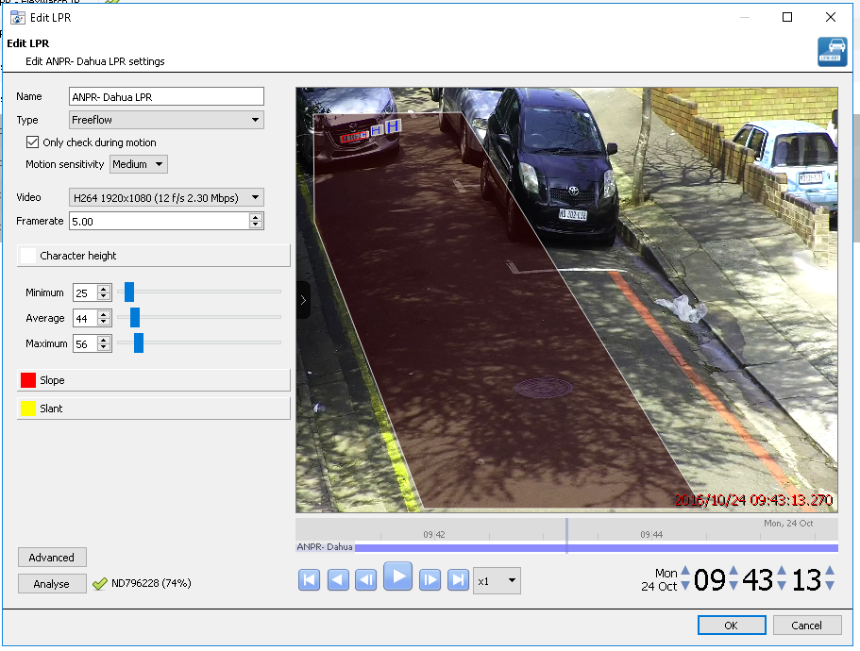
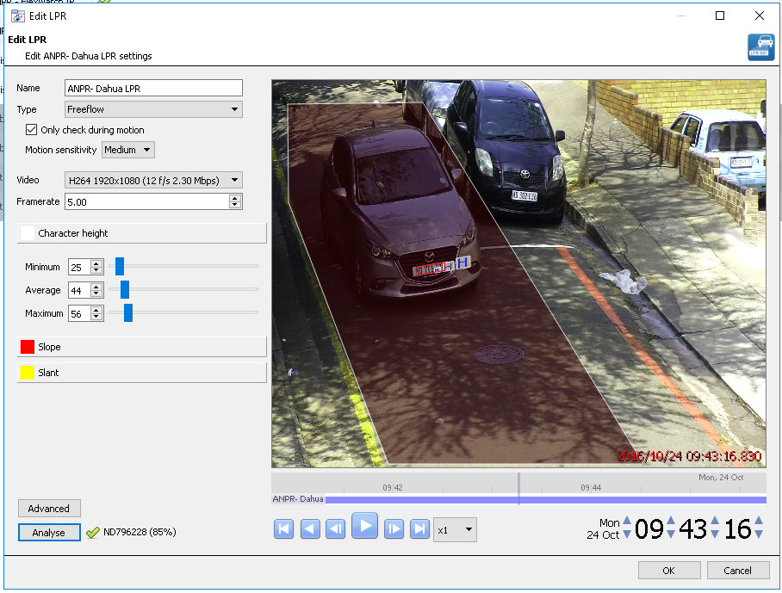
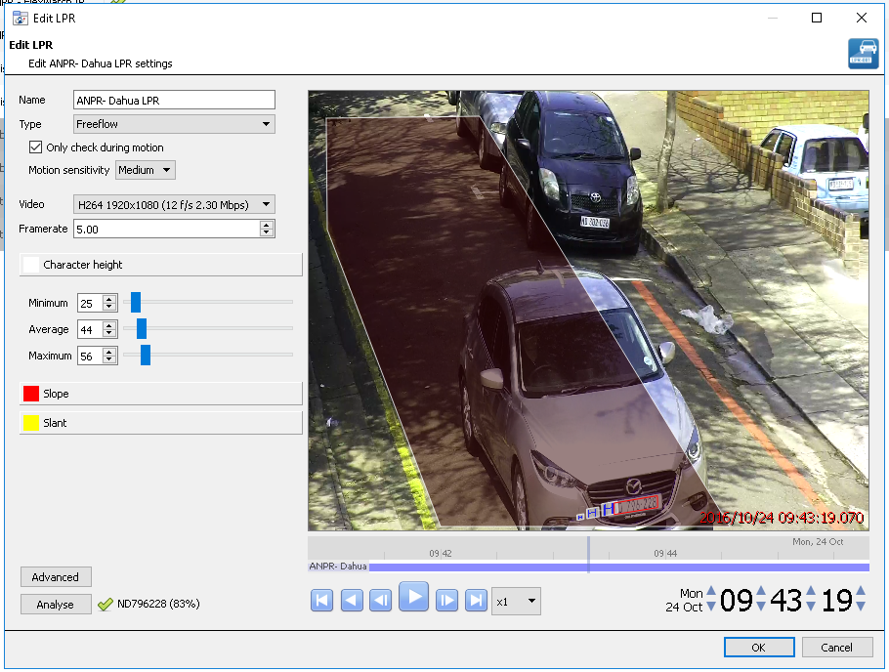
Minimum Character Height
Place a license plate at the beginning
of the capture area. This will be the
smallest the license plate will be.
Adjust the minimum character height
to match the size of the license plate
Average Character Height
Place a license plate at about the middle
of the capture area. This will be roughly
the average size the license plate will be.
Adjust the average character height
to match the size of the license plate
Maximum Character Height
Place a license plate at the end
of the capture area. This will be the
larges the license plate will be.
Adjust the maximum character height
to match the size of the license plate
Setting the Character Height like this will reduce the amount of false positives

Slide 22
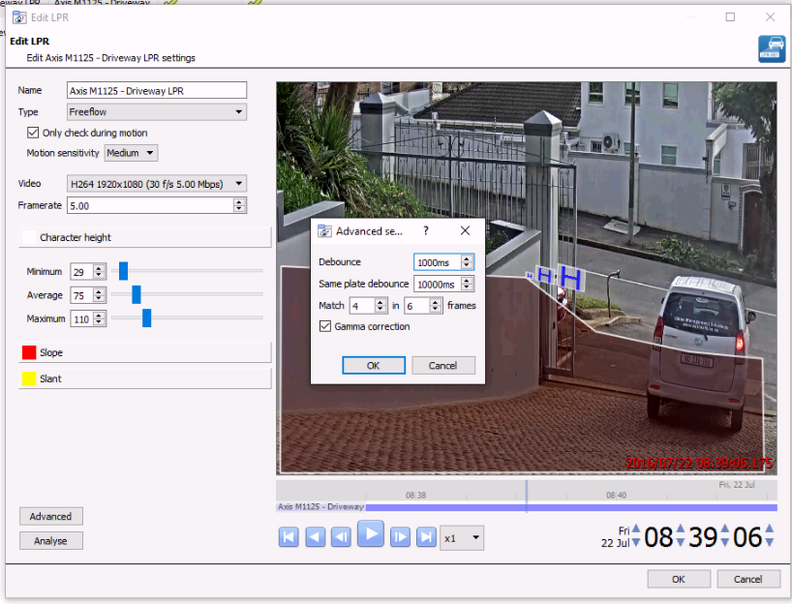
Select the correct feed for the camera
Choose the frame rate
a frame rate of 5 means that – the software will read the frames such that it uses 5 frames in a second
ie if camera is set at 20fps – the ANPR uses every 4th frame
if the camera is set at 30fps – the ANPR uses every 6th frame
if the camera frame rate is 60 fps – the ANPR uses every 12th frame
Adjust this for the best accuracy on the site – but generally
matching 4 of 6 frames works well
30 Frames per second
This shows that increasing the camera frame rate will not gain any real advantage, a slightly higher shutter speed reduces blur and generally leads to clearer images and hence a higher recognition rate.
Note that the higher the shutter speed, the more light is needed
20 Frames per second
1 second
Frame matches
This shows that a clearer image is better, so
a good bit rate, a lower compression and a higher
quality image results in more accurate reads
0 1 1 1 1 1 good recognition
1 1 1 0 0 0 no! only 3 of the last 6 frames match
1 1 1 0 0 1 good 4 of the last 6 frames match

Slide 23
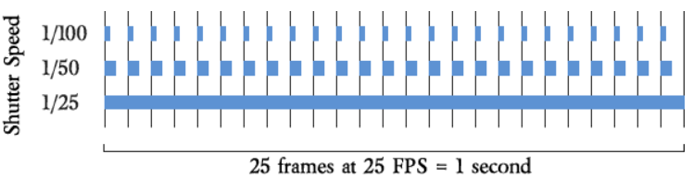
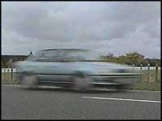
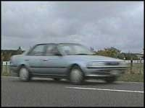
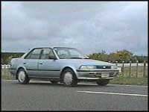
Frame rate ( frames per second) vs. Shutter speed
Frame Rate
refers to how many frames are generated
each second
Shutter Speed
Refers to how long the individual frame
is exposed to light
The blue bars represent the shutter speed ( on the left) and the portion of time taken in relation to the frame rate which in this case is 25
1/25 1/50 1/100
Keeping the frame rate constant, showing the effects of increasing the shutter speed
Note: As a result of the reduced exposure time with high shutter speeds, the image may appear darker unless the iris is opened to compensate, or more lighting is added.

Slide 24
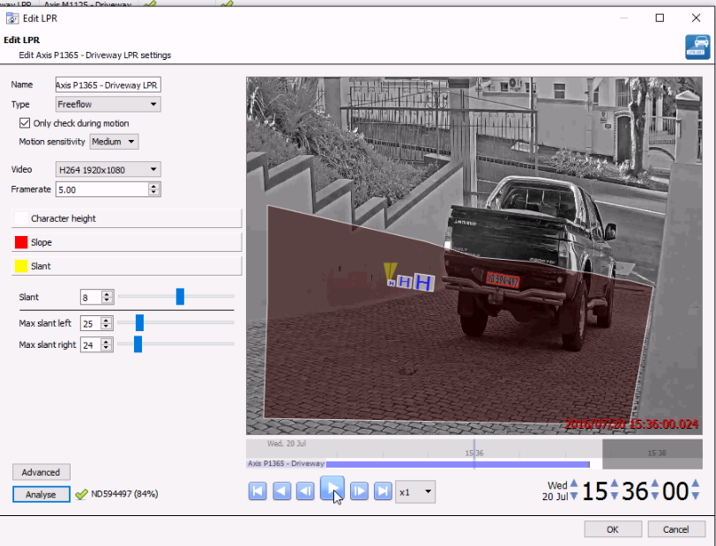
With a number-plate in the capture area, click the Analyse button, and check if the results are acceptable

Slide 25
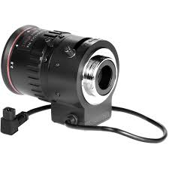
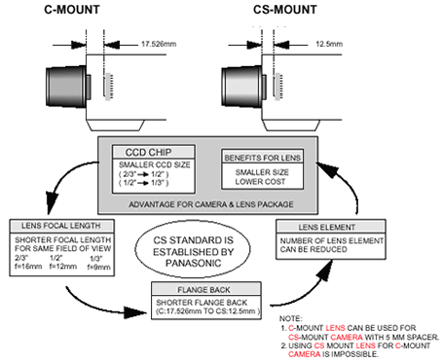
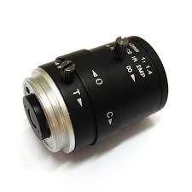
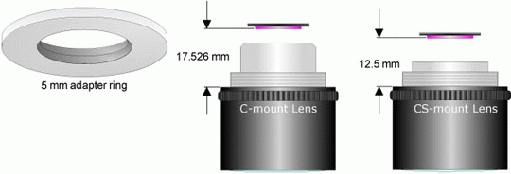
CS mount vs C mount If the lens

Slide 26
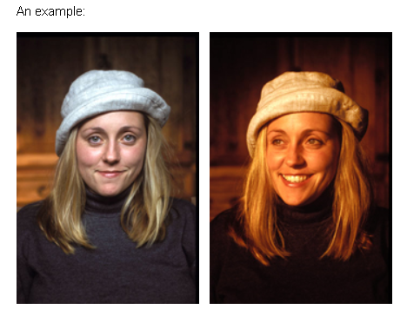
Lighting
Sufficient and good lighting is crucial for the correct operation
A point to note is the correct Colour rendering Index (CRI) of the Lighting
The image on the left is an example of a full spectrum light source with a kelvin temperature similar to natural daylight and a CRI of 93. The image on the right is from a halogen bulb source touted as having a "spectral match to daylight" and a CRI of 98. So why does her white hat appear yellow and not white in the photo? It is because the CRI calculation and spectral match was done against a 4100k reference source which is several shades more yellow than the actual sunlight striking the earth's surface. Remember CRI can only be determined by using a reference that has the same color temperature. A true spectral match to daylight would only occur in the 5000-6000k range, not at daylight if it were only 4100k! In our opinion, it is unfortunate that marketing strategies like this are allowed to exist, but can be easily avoided by the educated consumer.
Generally an good quality LED light with a CRI of 75 or above will render the colours correctly
so that the colours are interpreted correctly when they are analysed

Slide 27
Preliminary
ANPR Support Questions

Slide 28
Is camera mounted firmly?
( there must be no movement in the camera with respect to the ground, in other words, even the pole must be secure)
What is the camera model?
Is the lens the one supplied with the camera, or was another fitted
Which camera driver is being used
Is the topography of the area between the camera and the number plate flat or not
What is the approx. height of the camera
If the vehicle was traveling in a straight line, how far to the side is the camera mounted
What is the approx. distance from the camera lens to the furthest point when capturing the plate
What is the approx. distance from the camera lens to the closest point when capturing the plate
Is the vehicle traveling when capturing
What speed is vehicle traveling at
What is the camera shutter speed ( if vehicle speed exceeds 15km/hr)
What is the varifocal set at - near or far
( if lens is 3mm-8.5mm near is 3mm and far is 8.5mm)
What is the camera frame per second setting (20 fps)
What is the LPR frame setting ( 5 default)

Slide 29
What trigger is being used
Which language library is loaded
Is the ANPR engine being shown as licensed
What lighting is being used IR or visible
If IR lighting, is it on the camera or external
Is there a lot of advertising around the number plates

Slide 30
Image Sensor dimensions
 | H | V
1/1 | 12.8 | 9.6
1/1.2 | 10.67 | 8
1/1.7 | 7.6 | 5.7
1/1.8 | 7.18 | 5.32
1/2 | 6.4 | 4.8
1/2.3 | 6.17 | 4.55
1/2.5 | 5.76 | 4.29
1/2.7 | 5.27 | 3.96
1/2.8 | 4.95 | 3.705
1/3 | 4.8 | 3.6
1/3.2 | 4.54 | 3.42
1/3.6 | 4 | 3
2/3 | 8.8 | 6.6
1/4 | 3.2 | 2.4
Common horizontal and vertical Resolutions
Rotated 1 Megapixel | 720 | 1280
cif | 352 | 240
d1 | 720 | 480
1Mp | 1280 | 720
1.3mp | 1280 | 1024
2mp | 1920 | 1080
3mp | 2048 | 1536
5mp | 2560 | 1920
8mp | 3264 | 2448
10mp | 3648 | 2736
12mp | 4608 | 2592

